Slide 1
Testing Object Oriented Software
Chapter 15

Slide 2
Learning objectives
Understand how object orientation impacts software testing
  What characteristics matter? Why?
  What adaptations are needed?
    Understand basic techniques to cope with each key characteristic
Understand staging of unit and integration testing for OO software (intra-class and inter-class testing)
(c) 2008 Mauro Pezzè & Michal Young
Ch 15, slide <number>

Slide 3
Characteristics of OO Software
15.2
Typical OO software characteristics that impact testing
State dependent behavior
Encapsulation
Inheritance
Polymorphism and dynamic binding
Abstract and generic classes
Exception handling
(c) 2008 Mauro Pezzè & Michal Young
Ch 15, slide <number>

Slide 4
Quality activities and OO SW
(c) 2008 Mauro Pezzè & Michal Young
Ch 15, slide <number>

Slide 5
OO definitions of unit and integration testing
Procedural software
  unit = single program, function, or procedure
  more often: a unit of work that may correspond to one or more intertwined functions or programs
Object oriented software
  unit = class or (small) cluster of strongly related classes
  (e.g., sets of Java classes that correspond to exceptions)
  unit testing = intra-class testing
  integration testing = inter-class testing (cluster of classes)
  dealing with single methods separately is usually too expensive (complex scaffolding), so methods are usually tested in the context of the class they belong to
(c) 2008 Mauro Pezzè & Michal Young
Ch 15, slide <number>

Slide 6
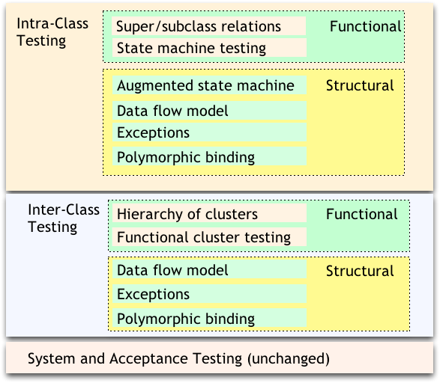
Orthogonal approach: Stages
15.3
(c) 2008 Mauro Pezzè & Michal Young
Ch 15, slide <number>

Slide 7
Intraclass State Machine Testing
15.4/5
Basic idea:
  The state of an object is modified by operations
  Methods can be modeled as state transitions
  Test cases are sequences of method calls that traverse the state machine model
State machine model can be derived from specification (functional testing), code (structural testing), or both
[ Later: Inheritance and dynamic binding ]
(c) 2008 Mauro Pezzè & Michal Young
Ch 15, slide <number>

Slide 8
Informal state-full specifications
Slot: represents a slot of a computer model.
.... slots can be bound or unbound. Bound slots are assigned a compatible component, unbound slots are empty. Class slot offers the following services:
Install: slots can be installed on a model as required or optional.
...
Bind: slots can be bound to a compatible component.
...
Unbind: bound slots can be unbound by removing the bound component.
IsBound: returns the current binding, if bound; otherwise returns the special value empty.
(c) 2008 Mauro Pezzè & Michal Young
Ch 15, slide <number>
Notes:
Part I: generating test cases from informal specifications:
Let us start with an informal description of a simple class slot of our running example: the web presence of the Chipmunk Coputer Company.

Slide 9
Identifying states and transitions
From the informal specification we can identify three states:
  Not_installed
  Unbound
  Bound
and four transitions
  install: from Not_installed to Unbound
  bind: from Unbound to Bound
  unbind: ...to Unbound
  isBound: does not change state
(c) 2008 Mauro Pezzè & Michal Young
Ch 15, slide <number>

Slide 10
Deriving an FSM and test cases
TC-1: incorporate, isBound, bind, isBound
TC-2: incorporate, unBind, bind, unBind, isBound
(c) 2008 Mauro Pezzè & Michal Young
Ch 15, slide <number>
Notes:
A simple analysis of the informal specification of class Slots allows to identify states and transitions.
The analysis reveals some ambiguities that have been solved in the finite state machine model.

Slide 11
Testing with State Diagrams
A statechart (called a “state diagram” in UML) may be produced as part of a specification or design
    May also be implied by a set of message sequence charts (interaction diagrams), or other modeling formalisms
Two options:
  Convert (“flatten”) into standard finite-state machine, then derive test cases
  Use state diagram model directly
(c) 2008 Mauro Pezzè & Michal Young
Ch 15, slide <number>

Slide 12
Statecharts specification
class model
method of
class Model
super-state or
“OR-state”
called by
class Model
(c) 2008 Mauro Pezzè & Michal Young
Ch 15, slide <number>
Notes:
Part II: generating test cases from Statechart specifications:
a Statechart specification for class Model of the business logic of the Chipmunk web presence.
Class Model allows for selecting a computer model and selecting a set of components to fill in logical and physical slots.

Slide 13
From Statecharts to FSMs
(c) 2008 Mauro Pezzè & Michal Young
Ch 15, slide <number>
Notes:
Statecharts can be easily mapped to FSMs.
Notice that transition selectModel of the Statechart corresponds to a single
transition in the FSM, since the OR-state is entered with default, while transition deselectModel of the Statechart corresponds to two transitions in the FSM, one for each of the two children states, since each child state is a possible source of the transition.

Slide 14
Statechart based criteria
In some cases, “flattening” a Statechart to a finite-state machine may cause “state explosion”
    Particularly for super-states with “history”
Alternative: Use the statechart directly
Simple transition coverage:
execute all transitions of the original Statechart
    incomplete transition coverage of corresponding FSM
    useful for complex statecharts and strong time constraints (combinatorial number of transitions)
(c) 2008 Mauro Pezzè & Michal Young
Ch 15, slide <number>

Slide 15
Interclass Testing
15.6
The first level of integration testing for object-oriented software
  Focus on interactions between classes
Bottom-up integration according to “depends” relation
  A depends on B: Build and test B, then A
Start from use/include hierarchy
      Implementation-level parallel to logical “depends” relation
    Class A makes method calls on class B
    Class A objects include references to class B methods
      but only if reference means “is part of”
(c) 2008 Mauro Pezzè & Michal Young
Ch 15, slide <number>

Slide 16
from a class diagram...
(c) 2008 Mauro Pezzè & Michal Young
Ch 15, slide <number>

Slide 17
....to a hierarchy
Note: we may have to break loops and generate stubs
(c) 2008 Mauro Pezzè & Michal Young
Ch 15, slide <number>

Slide 18
Interactions in Interclass Tests
Proceed bottom-up
Consider all combinations of interactions
  example: a test case for class Order includes a call to a method of class Model, and the called method calls a method of class Slot, exercise all possible relevant states of the different classes
  problem: combinatorial explosion of cases
  so select a subset of interactions:
    arbitrary or random selection
    plus all significant interaction scenarios that have been previously identified in design and analysis: sequence + collaboration diagrams
(c) 2008 Mauro Pezzè & Michal Young
Ch 15, slide <number>

Slide 19
sequence diagram
(c) 2008 Mauro Pezzè & Michal Young
Ch 15, slide <number>

Slide 20
Using Structural Information
15.7
Start with functional testing
  As for procedural software, the specification (formal or informal) is the first source of information for testing object-oriented software
    “Specification” widely construed: Anything from a requirements document to a design model or detailed interface description
Then add information from the code (structural testing)
  Design and implementation details not available from other sources
(c) 2008 Mauro Pezzè & Michal Young
Ch 15, slide <number>

Slide 21
From the implementation ...
public class Model extends Orders.CompositeItem {
....
private boolean legalConfig = false; // memoized
....
public boolean isLegalConfiguration() {
if (! legalConfig) {
checkConfiguration();
}
return legalConfig;
}
.....
private void checkConfiguration() {
legalConfig = true;
for (int i=0; i < slots.length; ++i) {
Slot slot = slots[i];
if (slot.required && ! slot.isBound()) {
legalConfig = false;
} ...} ... }
......
private instance
variable
private method
(c) 2008 Mauro Pezzè & Michal Young
Ch 15, slide <number>

Slide 22
Intraclass data flow testing
Exercise sequences of methods
  From setting or modifying a field value
  To using that field value
We need a control flow graph that encompasses more than a single method ...
(c) 2008 Mauro Pezzè & Michal Young
Ch 15, slide <number>

Slide 23
The intraclass control flow graph
Control flow for each method
+
node for class
+
edges
  from node class to the start nodes of the methods
  from the end nodes of the methods to node class
=> control flow through sequences of method calls
Method addComponent
Method selectModel
Method checkConfiguration
class Model
(c) 2008 Mauro Pezzè & Michal Young
Ch 15, slide <number>

Slide 24
Interclass structural testing
Working “bottom up” in dependence hierarchy
    Dependence is not the same as class hierarchy; not always the same as call or inclusion relation.
    May match bottom-up build order
  Starting from leaf classes, then classes that use leaf classes, ...
Summarize effect of each method: Changing or using object state, or both
  Treating a whole object as a variable (not just primitive types)
(c) 2008 Mauro Pezzè & Michal Young
Ch 15, slide <number>

Slide 25
Inspectors and modifiers
Classify methods (execution paths) as
  inspectors: use, but do not modify, instance variables
  modifiers: modify, but not use instance variables
  inspector/modifiers: use and modify instance variables
Example – class slot:
  Slot() modifier
  bind() modifier
  unbind() modifier
  isbound() inspector
(c) 2008 Mauro Pezzè & Michal Young
Ch 15, slide <number>

Slide 26
Definition-Use (DU) pairs
instance variable legalConfig
<model (1.2), isLegalConfiguration (7.2)>
<addComponent (4.6), isLegalConfiguration (7.2)>
<removeComponent (5.4), isLegalConfiguration (7.2)>
<checkConfiguration (6.2), isLegalConfiguration (7.2)>
<checkConfiguration (6.3), isLegalConfiguration (7.2)>
<addComponent (4.9), isLegalConfiguration (7.2)>
Each pair corresponds to a test case
note that
some pairs may be infeasible
to cover pairs we may need to find complex sequences
(c) 2008 Mauro Pezzè & Michal Young
Ch 15, slide <number>

Slide 27
Definitions from modifiers
Definitions of instance variable slot in class model
addComponent (4.5)
addComponent (4.7)
addComponent (4.8)
selectModel (2.3)
removeComponent (5.3)
Slot() modifier
bind() modifier
unbind() modifier
isbound() inspector
(c) 2008 Mauro Pezzè & Michal Young
Ch 15, slide <number>

Slide 28
Uses from inspectors
Uses of instance variables slot in class model
removeComponent (5.2)
checkConfiguration (6.4)
checkConfiguration (6.5)
checkConfiguration (6.7)
Slot slot =slots[slotIndex];
Slot() modifier
bind() modifier
unbind() modifier
isbound() inspector
(c) 2008 Mauro Pezzè & Michal Young
Ch 15, slide <number>

Slide 29
Stubs, Drivers, and Oracles for Classes
15.8
Problem: State is encapsulated
  How can we tell whether a method had the correct effect?
Problem: Most classes are not complete programs
  Additional code must be added to execute them
We typically solve both problems together, with scaffolding
(c) 2008 Mauro Pezzè & Michal Young
Ch 15, slide <number>

Slide 30
Scaffolding
Tool example:
JUnit
Driver
Classes to be tested
Tool example:
MockMaker
Stubs
(c) 2008 Mauro Pezzè & Michal Young
Ch 15, slide <number>
Notes:
A test scaffolding is composed of
one or more drivers, that provide a prototype activation environment for the unit under test . For procedural programs, drivers initialize non-local variables and parameters, and call the unit.
one or more stubs, that provides a prototype of the units used by the program to be tested.
one or more oracles, i.e., acceptors, that identify the tests that cause failures.

Slide 31
Approaches
Requirements on scaffolding approach: Controllability and Observability
General/reusable scaffolding
  Across projects; build or buy tools
Project-specific scaffolding
  Design for test
  Ad hoc, per-class or even per-test-case
Usually a combination
(c) 2008 Mauro Pezzè & Michal Young
Ch 15, slide <number>

Slide 32
Oracles
Test oracles must be able to check the correctness of the behavior of the object when executed with a given input
Behavior produces outputs and brings an object into a new state
  We can use traditional approaches to check for the correctness of the output
  To check the correctness of the final state we need to access the state
(c) 2008 Mauro Pezzè & Michal Young
Ch 15, slide <number>

Slide 33
Accessing the state
Intrusive approaches
  use language constructs (C++ friend classes)
  add inspector methods
  in both cases we break encapsulation and we may produce undesired results
Equivalent scenarios approach:
  generate equivalent and non-equivalent sequences of method invocations
  compare the final state of the object after equivalent and non-equivalent sequences
(c) 2008 Mauro Pezzè & Michal Young
Ch 15, slide <number>

Slide 34
Equivalent Scenarios Approach
selectModel(M1)
addComponent(S1,C1)
addComponent(S2,C2)
isLegalConfiguration()
deselectModel()
selectModel(M2)
addComponent(S1,C1)
isLegalConfiguration()
EQUIVALENT
selectModel(M2)
addComponent(S1,C1)
isLegalConfiguration()
NON EQUIVALENT
selectModel(M2)
addComponent(S1,C1)
addComponent(S2,C2)
isLegalConfiguration()
(c) 2008 Mauro Pezzè & Michal Young
Ch 15, slide <number>

Slide 35
Generating equivalent sequences
remove unnecessary (“circular”) methods
selectModel(M1)
addComponent(S1,C1)
addComponent(S2,C2)
isLegalConfiguration()
deselectModel()
selectModel(M2)
addComponent(S1,C1)
isLegalConfiguration()
(c) 2008 Mauro Pezzè & Michal Young
Ch 15, slide <number>

Slide 36
Generating non-equivalent scenarios
selectModel(M1)
addComponent(S1,C1)
Remove and/or shuffle essential actions
Try generating sequences that resemble real faults
addComponent(S2,C2)
isLegalConfiguration()
deselectModel()
selectModel(M2)
addComponent(S1,C1)
isLegalConfiguration()
(c) 2008 Mauro Pezzè & Michal Young
Ch 15, slide <number>

Slide 37
Verify equivalence
In principle: Two states are equivalent if all possible sequences of methods starting from those states produce the same results
Practically:
add inspectors that disclose hidden state and compare the results
  break encapsulation
examine the results obtained by applying a set of methods
  approximate results
add a method “compare” that specializes the default equal method
  design for testability
(c) 2008 Mauro Pezzè & Michal Young
Ch 15, slide <number>

Slide 38
Polymorphism and dynamic binding
15.9
  One variable potentially bound to methods of different (sub-)classes

Slide 39
“Isolated” calls: the combinatorial explosion problem
abstract class Credit {
...
abstract boolean validateCredit( Account a, int amt, CreditCard c);
...
}
EduCredit
BizCredit
IndividualCredit
USAccount
UKAccount
EUAccount
JPAccount
OtherAccount
VISACard
AmExpCard
StoreCard
The combinatorial problem: 3 x 5 x 3 = 45 possible combinations
of dynamic bindings (just for this one method!)
(c) 2008 Mauro Pezzè & Michal Young
Ch 15, slide <number>

Slide 40
The combinatorial approach
Identify a set of combinations that cover all pairwise combinations of dynamic bindings
Account | Credit | creditCard
USAccount | EduCredit | VISACard
USAccount | BizCredit | AmExpCard
USAccount | individualCredit | ChipmunkCard
UKAccount | EduCredit | AmExpCard
UKAccount | BizCredit | VISACard
UKAccount | individualCredit | ChipmunkCard
EUAccount | EduCredit | ChipmunkCard
EUAccount | BizCredit | AmExpCard
EUAccount | individualCredit | VISACard
JPAccount | EduCredit | VISACard
JPAccount | BizCredit | ChipmunkCard
JPAccount | individualCredit | AmExpCard
OtherAccount | EduCredit | ChipmunkCard
OtherAccount | BizCredit | VISACard
OtherAccount | individualCredit | AmExpCard
Same motivation as pairwise specification-based testing
(c) 2008 Mauro Pezzè & Michal Young
Ch 15, slide <number>

Slide 41
Combined calls: undesired effects
public abstract class Account { ...
public int getYTDPurchased() {
if (ytdPurchasedValid) { return ytdPurchased; }
int totalPurchased = 0;
for (Enumeration e = subsidiaries.elements() ; e.hasMoreElements(); )
{ Account subsidiary = (Account) e.nextElement();
totalPurchased += subsidiary.getYTDPurchased();
}
for (Enumeration e = customers.elements(); e.hasMoreElements(); )
{ Customer aCust = (Customer) e.nextElement();
totalPurchased += aCust.getYearlyPurchase();
}
ytdPurchased = totalPurchased;
ytdPurchasedValid = true;
return totalPurchased;
} … }
Problem:
different implementations of methods getYDTPurchased refer to different currencies.
(c) 2008 Mauro Pezzè & Michal Young
Ch 15, slide <number>

Slide 42
A data flow approach
step 1: identify polymorphic calls, binding sets, defs and uses
public abstract class Account {
...
public int getYTDPurchased() {
if (ytdPurchasedValid) { return ytdPurchased; }
int totalPurchased = 0;
for (Enumeration e = subsidiaries.elements() ; e.hasMoreElements(); )
{
Account subsidiary = (Account) e.nextElement();
totalPurchased += subsidiary.getYTDPurchased();
}
for (Enumeration e = customers.elements(); e.hasMoreElements(); )
{
Customer aCust = (Customer) e.nextElement();
totalPurchased += aCust.getYearlyPurchase();
}
ytdPurchased = totalPurchased;
ytdPurchasedValid = true;
return totalPurchased;
}
…
}
totalPurchased defined
totalPurchased
used and defined
totalPurchased
used and defined
totalPurchased used
totalPurchased used
(c) 2008 Mauro Pezzè & Michal Young
Ch 15, slide <number>

Slide 43
Def-Use (dataflow) testing of polymorphic calls
Derive a test case for each possible polymorphic <def,use> pair
  Each binding must be considered individually
  Pairwise combinatorial selection may help in reducing the set of test cases
Example: Dynamic binding of currency
  We need test cases that bind the different calls to different methods in the same run
  We can reveal faults due to the use of different currencies in different methods
(c) 2008 Mauro Pezzè & Michal Young
Ch 15, slide <number>

Slide 44
Inheritance
15.10
When testing a subclass ...
  We would like to re-test only what has not been thoroughly tested in the parent class
    for example, no need to test hashCode and getClass methods inherited from class Object in Java
  But we should test any method whose behavior may have changed
    even accidentally!
(c) 2008 Mauro Pezzè & Michal Young
Ch 15, slide <number>

Slide 45
Reusing Tests with the Testing History Approach
Track test suites and test executions
  determine which new tests are needed
  determine which old tests must be re-executed
New and changed behavior ...
  new methods must be tested
  redefined methods must be tested, but we can partially reuse test suites defined for the ancestor
  other inherited methods do not have to be retested
(c) 2008 Mauro Pezzè & Michal Young
Ch 15, slide <number>

Slide 46
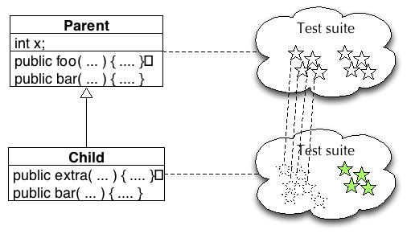
Testing history
(c) 2008 Mauro Pezzè & Michal Young
Ch 15, slide <number>

Slide 47
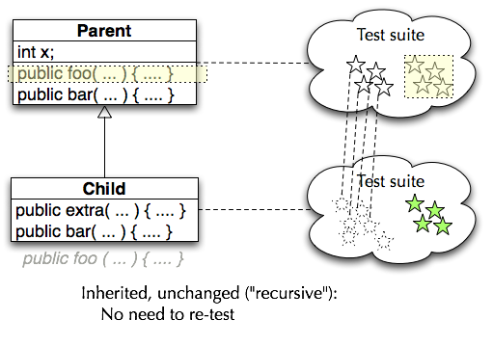
Inherited, unchanged
(c) 2008 Mauro Pezzè & Michal Young
Ch 15, slide <number>

Slide 48
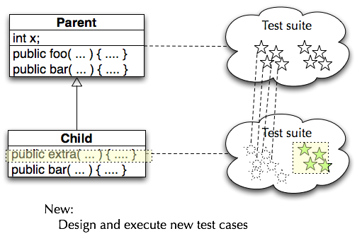
Newly introduced methods
(c) 2008 Mauro Pezzè & Michal Young
Ch 15, slide <number>

Slide 49
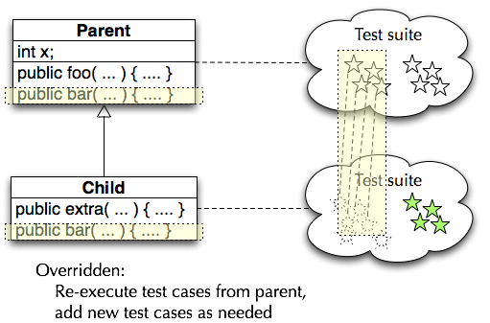
Overridden methods
(c) 2008 Mauro Pezzè & Michal Young
Ch 15, slide <number>

Slide 50
Testing History – some details
Abstract methods (and classes)
  Design test cases when abstract method is introduced (even if it can’t be executed yet)
Behavior changes
  Should we consider a method “redefined” if another new or redefined method changes its behavior?
    The standard “testing history” approach does not do this
    It might be reasonable combination of data flow (structural) OO testing with the (functional) testing history approach
(c) 2008 Mauro Pezzè & Michal Young
Ch 15, slide <number>
Notes:
(Note that the “Behavior

Slide 51
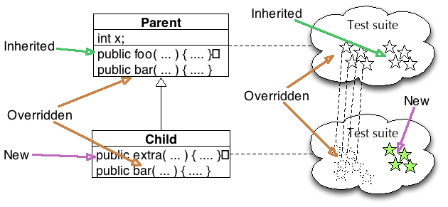
Testing History - Summary
(c) 2008 Mauro Pezzè & Michal Young
Ch 15, slide <number>

Slide 52
Does testing history help?
Executing test cases should (usually) be cheap
  It may be simpler to re-execute the full test suite of the parent class
  ... but still add to it for the same reasons
But sometimes execution is not cheap ...
  Example: Control of physical devices
  Or very large test suites
    Ex: Some Microsoft product test suites require more than one night (so daily build cannot be fully tested)
  Then some use of testing history is profitable
(c) 2008 Mauro Pezzè & Michal Young
Ch 15, slide <number>

Slide 53
Testing generic classes
15.11
a generic class
class PriorityQueue<Elem Implements Comparable> {...}
is designed to be instantiated with many different parameter types
PriorityQueue<Customers>
PriorityQueue<Tasks>
A generic class is typically designed to behave consistently some set of permitted parameter types.
Testing can be broken into two parts
  Showing that some instantiation is correct
  showing that all permitted instantiations behave consistently
(c) 2008 Mauro Pezzè & Michal Young
Ch 15, slide <number>

Slide 54
Show that some instantiation is correct
Design tests as if the parameter were copied textually into the body of the generic class.
  We need source code for both the generic class and the parameter class
(c) 2008 Mauro Pezzè & Michal Young
Ch 15, slide <number>

Slide 55
Identify (possible) interactions
Identify potential interactions between generic and its parameters
  Identify potential interactions by inspection or analysis, not testing
  Look for: method calls on parameter object, access to parameter fields, possible indirect dependence
  Easy case is no interactions at all (e.g., a simple container class)
Where interactions are possible, they will need to be tested
(c) 2008 Mauro Pezzè & Michal Young
Ch 15, slide <number>

Slide 56
Example interaction
class PriorityQueue
<Elem implements Comparable> {...}
Priority queue uses the “Comparable” interface of Elem to make method calls on the generic parameter
We need to establish that it does so consistently
  So that if priority queue works for one kind of Comparable element, we can have some confidence it does so for others
(c) 2008 Mauro Pezzè & Michal Young
Ch 15, slide <number>

Slide 57
Testing variation in instantiation
We can’t test every possible instantiation
  Just as we can’t test every possible program input
... but there is a contract (a specification) between the generic class and its parameters
  Example: “implements Comparable” is a specification of possible instantiations
  Other contracts may be written only as comments
Functional (specification-based) testing techniques are appropriate
  Identify and then systematically test properties implied by the specification
(c) 2008 Mauro Pezzè & Michal Young
Ch 15, slide <number>

Slide 58
Example: Testing instantiation variation
Most but not all classes that implement Comparable also satisfy the rule
(x.compareTo(y) == 0) == (x.equals(y))
(from java.lang.Comparable)
So test cases for PriorityQueue should include
instantiations with classes that do obey this rule:
class String
instantiations that violate the rule:
class BigDecimal with values 4.0 and 4.00
(c) 2008 Mauro Pezzè & Michal Young
Ch 15, slide <number>

Slide 59
Exception handling
15.12
exceptions create implicit control flows and may be handled by different handlers
void addCustomer(Customer theCust) {
customers.add(theCust);
}
public static Account
newAccount(...)
throws InvalidRegionException
{
Account thisAccount = null;
String regionAbbrev = Regions.regionOfCountry(
mailAddress.getCountry());
if (regionAbbrev == Regions.US) {
thisAccount = new USAccount();
} else if (regionAbbrev == Regions.UK) {
....
} else if (regionAbbrev == Regions.Invalid) {
throw new InvalidRegionException(mailAddress.getCountry());
}
...
}
(c) 2008 Mauro Pezzè & Michal Young
Ch 15, slide <number>

Slide 60
Testing exception handling
Impractical to treat exceptions like normal flow
    too many flows: every array subscript reference, every memory allocation, every cast, ...
    multiplied by matching them to every handler that could appear immediately above them on the call stack.
    many actually impossible
So we separate testing exceptions
    and ignore program error exceptions (test to prevent them, not to handle them)
What we do test: Each exception handler, and each explicit throw or re-throw of an exception
(c) 2008 Mauro Pezzè & Michal Young
Ch 15, slide <number>

Slide 61
Testing program exception handlers
Local exception handlers
  test the exception handler (consider a subset of points bound to the handler)
Non-local exception handlers
  Difficult to determine all pairings of <points, handlers>
  So enforce (and test for) a design rule:
  if a method propagates an exception, the method call should have no other effect
(c) 2008 Mauro Pezzè & Michal Young
Ch 15, slide <number>

Slide 62
Summary
Several features of object-oriented languages and programs impact testing
  from encapsulation and state-dependent structure to generics and exceptions
  but only at unit and subsystem levels
  and fundamental principles are still applicable
Basic approach is orthogonal
  Techniques for each major issue (e.g., exception handling, generics, inheritance, ...) can be applied incrementally and independently
(c) 2008 Mauro Pezzè & Michal Young
Ch 15, slide <number>

